Slide 1

MARAMA Diesel Tampering Emissions Estimation Tool
Jenny St. Clair, Susan McCusker, Debbie Wilson (MARAMA)
MARAMA Mobile Sources Workshop
March 17, 2021
1

Slide 2
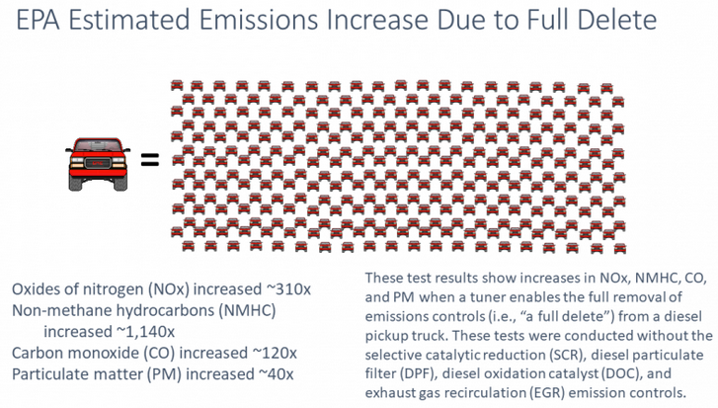
Background
https://cleanairact.org/wp-content/uploads/2019/09/Tampering-and-Aftermarket-Defeat-Devices-Phil-Brooks.pdf
2
2

Slide 3
We are still learning.
We don’t know exactly how many vehicles have tampered equipment.
Further data collection and research is needed.
3

Slide 4

Purpose
This tool is designed to provide flexible estimates of annual NOx and PM2.5 emissions for Mid-Atlantic and Northeast states using user-input data.
As newer and more robust data about illegal tampering of emissions control devices on diesel vehicles becomes available, this tool will allow states to update their estimates on the fly.
4

Slide 5
Data
2017 NEI
2011 NEI
2014 NEI
5

Slide 6
Assumptions
The 2011, 2014, and 2017 NEIs do not account for tampering
People who drive diesel vehicles with tampered equipment are unlikely to switch to electric vehicles
6

Slide 7
How to access the tool
http://jennifer-s.shinyapps.io/MARAMA-Diesel-Tampering-Tool
https://github.com/geojenn/Diesel-Tampering
7

Slide 8
Feedback
Please let me know if you have any feedback on the tool if/when you get the chance to run it.
jstclair@marama.org
8
8

Slide 9
R Shiny
Enables R users to create applications for data analysis relatively easily
https://shiny.rstudio.com/
https://shiny.rstudio.com/gallery/
9

Slide 10
MARAMA R Exchange
The MARAMA R Exchange provides a setting for air quality professionals to discuss technical/research projects that implement the R programming language.
To register: https://attendee.gotowebinar.com/register/215977479620447504
10

Slide 11
Thank you!
Contact: jstclair@marama.org, smccusker@marama.org, dwilson@marama.org
11

